Slide 1
Tabacco online shop
Team members:
Turmukhanbet Madiyar, Kozin Rustam, Muralinov Sanzhar

Slide 2
Plan of the project
1. Introduction
Purpose
2. Overall description
Product features
Operating environment
Statistics and market analysis
3. Design pattern – Adapter design pattern
4. Used technologies in development
HTML 5, CSS 3, ANGULAR, DJANGO, SQLite
5. SDLC – Agile
6. Conclusion
victrix team

Slide 3
TEAM MEMBERS
Turmukhanbet Madiyar | front-end developer
Muratkanova Meruyert | Project Manager
Kozin Rustam | Back-End developer
Muralinov Sanzhar | graphic designer
Mynzhassar Dias | back-End developer
victrix team

Slide 4

Introduction
The main target for our project. The main of idea of our project is making online shop for selling tobacco production. It is very perspective market due to the fact there are 46% of men and 5% of women smoking in Kazakhstan. And for this purpose there is no special online shops. For example we do not have online shops which selling imported and exclusive cigarettes.
victrix team

Slide 5

victrix team

Slide 6

Requirements collections
Satisfying the tobacco market needs
Technical working draft
Users support
victrix team

Slide 7
Сompetitor analysis
1 | «ВигВам»
2 | «VapeTeam»
3 | «IQOS shop»
4 | «Табачная лавка»
5 | «Табакoff»
victrix team

Slide 8
Price statistic

Slide 9







Technologies
victrix team

Slide 10
SDLC
Software development life cycle (SDLC) is a series of phases that provide a common understanding of the software building process.
Planning, Implementation, Documentation, Testing, Deployment and maintenance, Maintaining
One of the most famous system is Agile.
Able to think and understand quickly.
victrix team

Slide 11
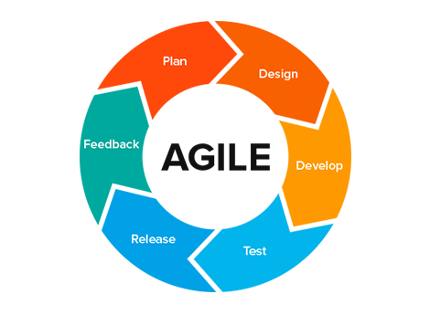
Why did we choose agile?
Able to move quickly and easily.
Simplifies processes and development
Actively use feedback.
Allows development processes to be flexible.
Work in short cycles.
victrix team

Slide 12
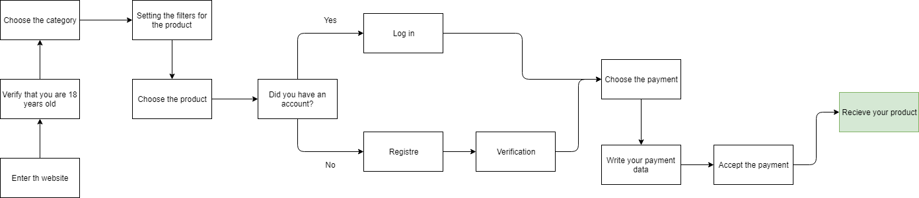
victrix team

Slide 13
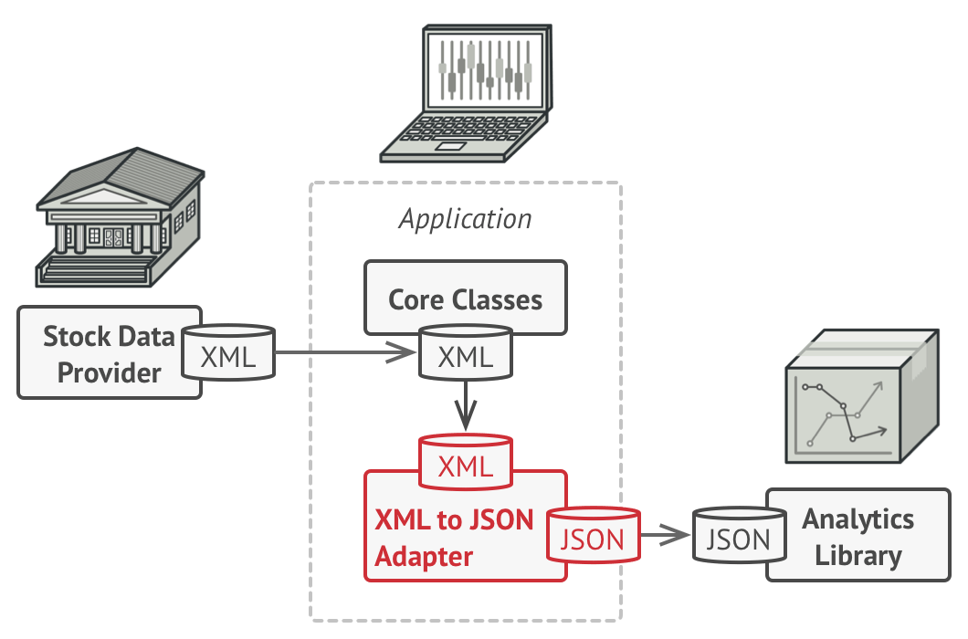
Adapter pattern

Slide 14

site security
Using secure protocol HTTPS(HyperText Transfer Protocol Secure) - HTTP protocol extension to support encryption for increased security
Using the password encryption algorithm.
Storing only the necessary data in the database
Full check to avoid SQL injections
Continuous updating of frameworks and libraries
Use of reliable hosting and servers

Slide 15
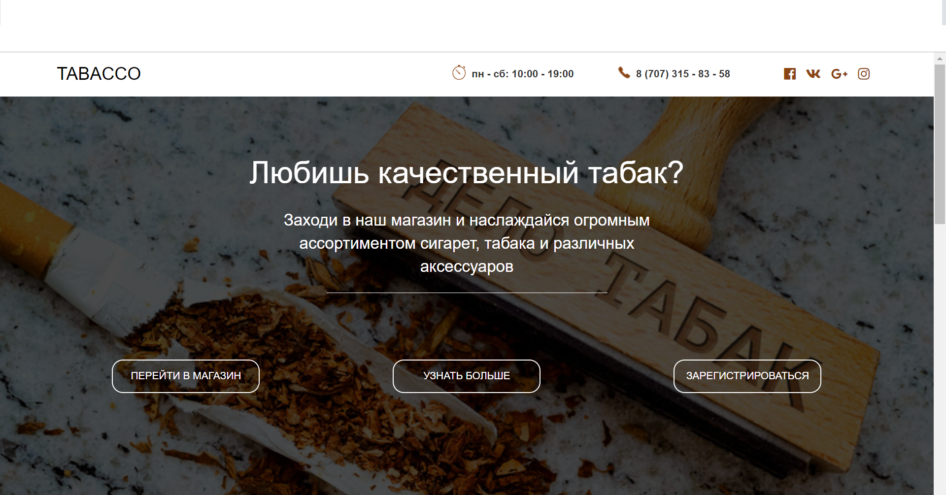

Slide 16
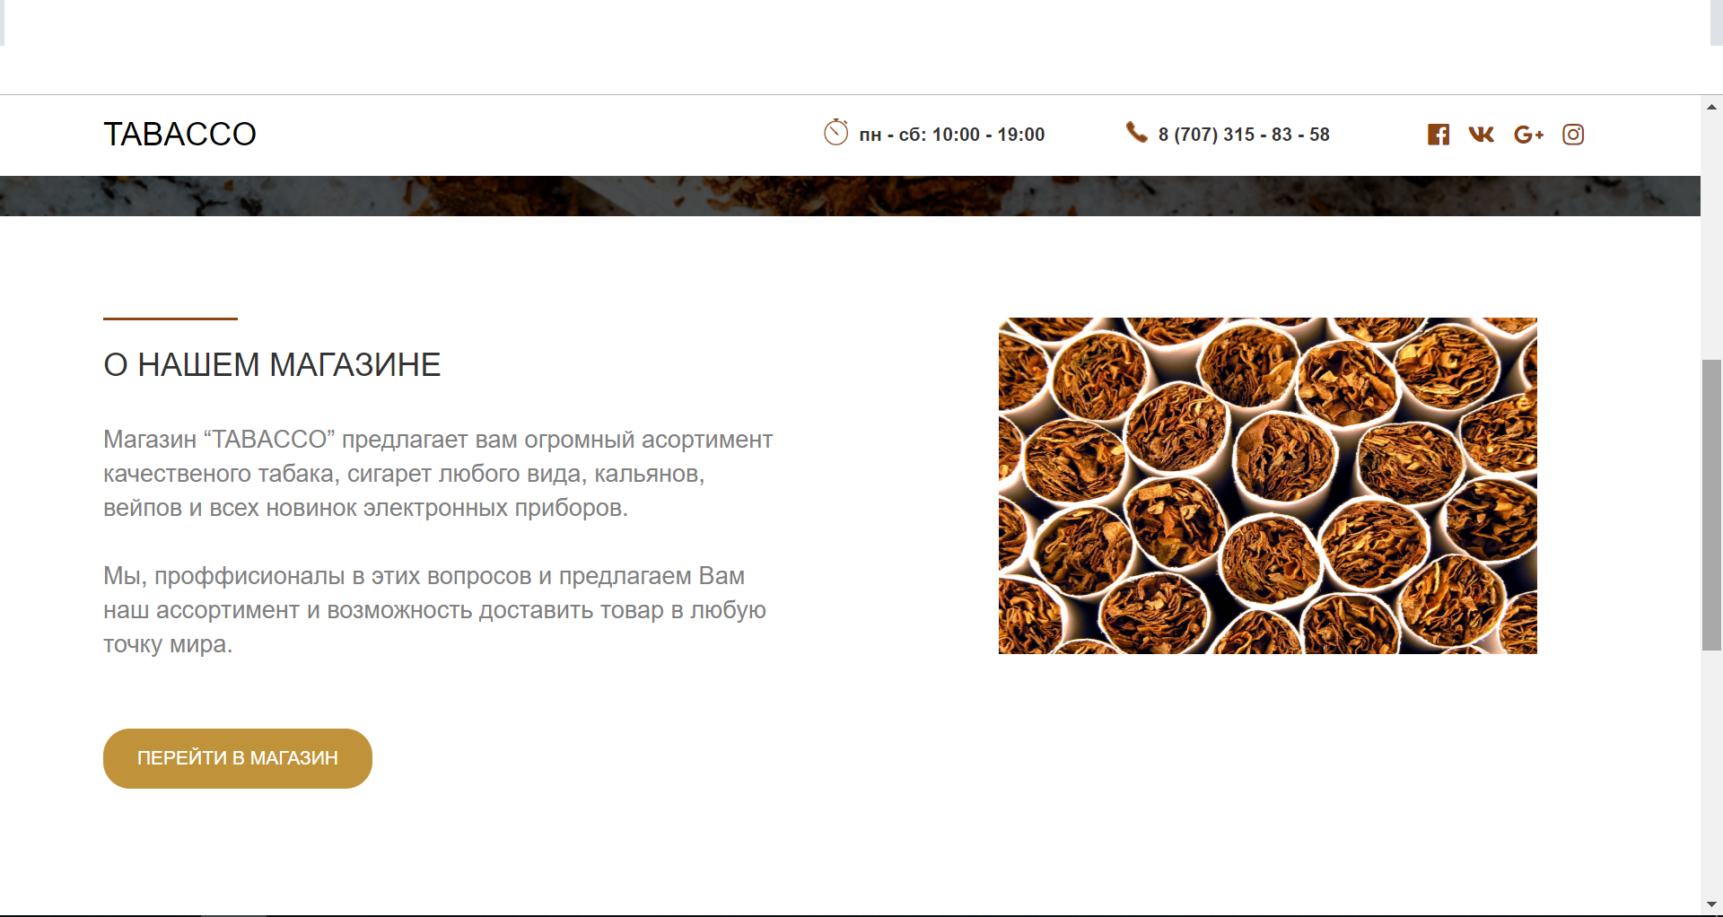

Slide 17
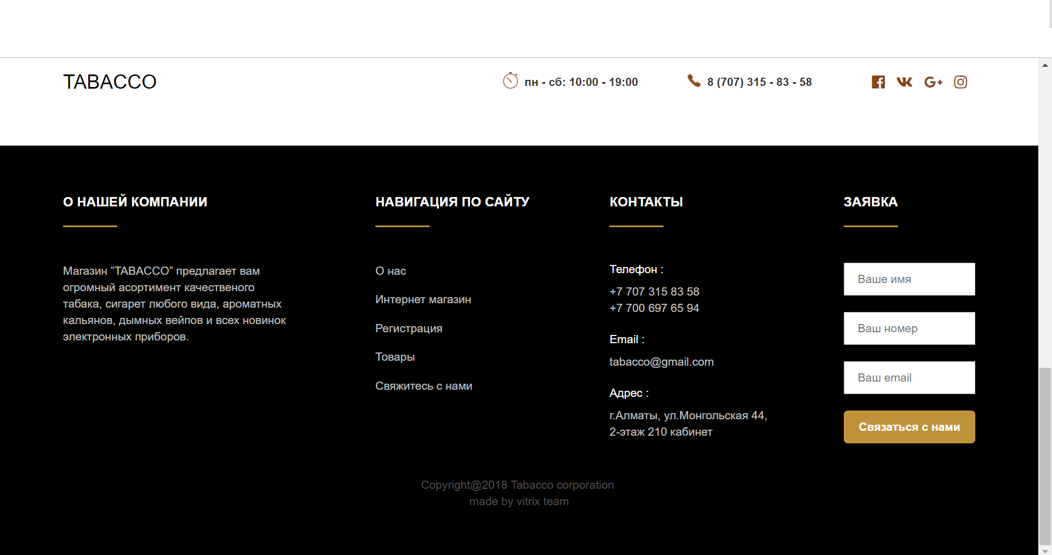

Slide 18
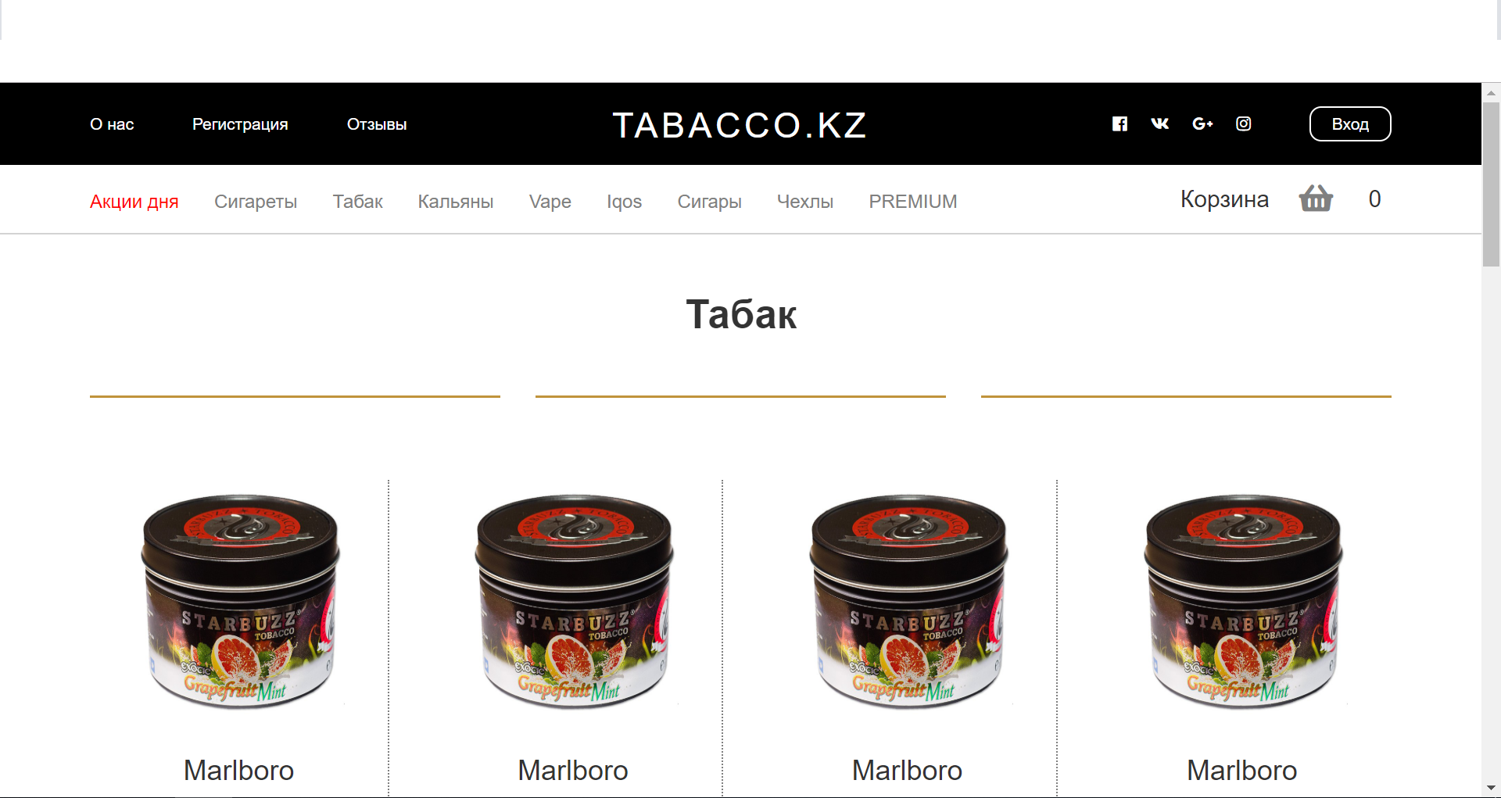

Slide 19
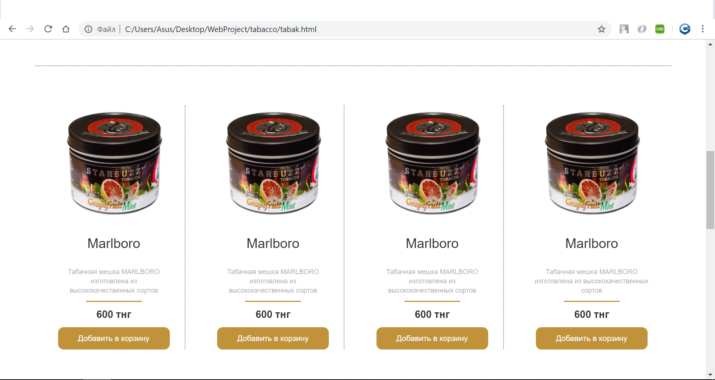

Slide 20

angular
Simplifies the amount of code
Simplifies working with dynamic elements.
Allows you to divide the site into logical components
Structures the site and logic

Slide 21
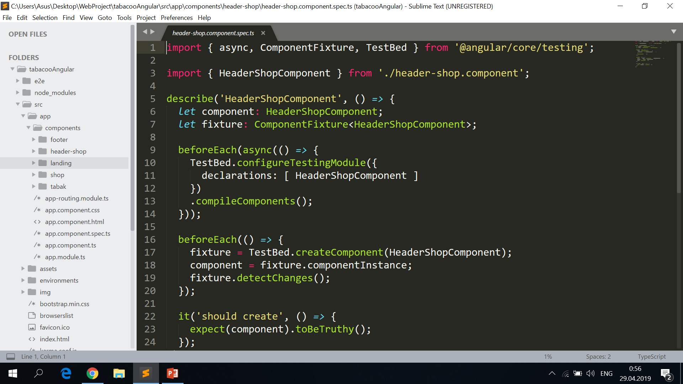
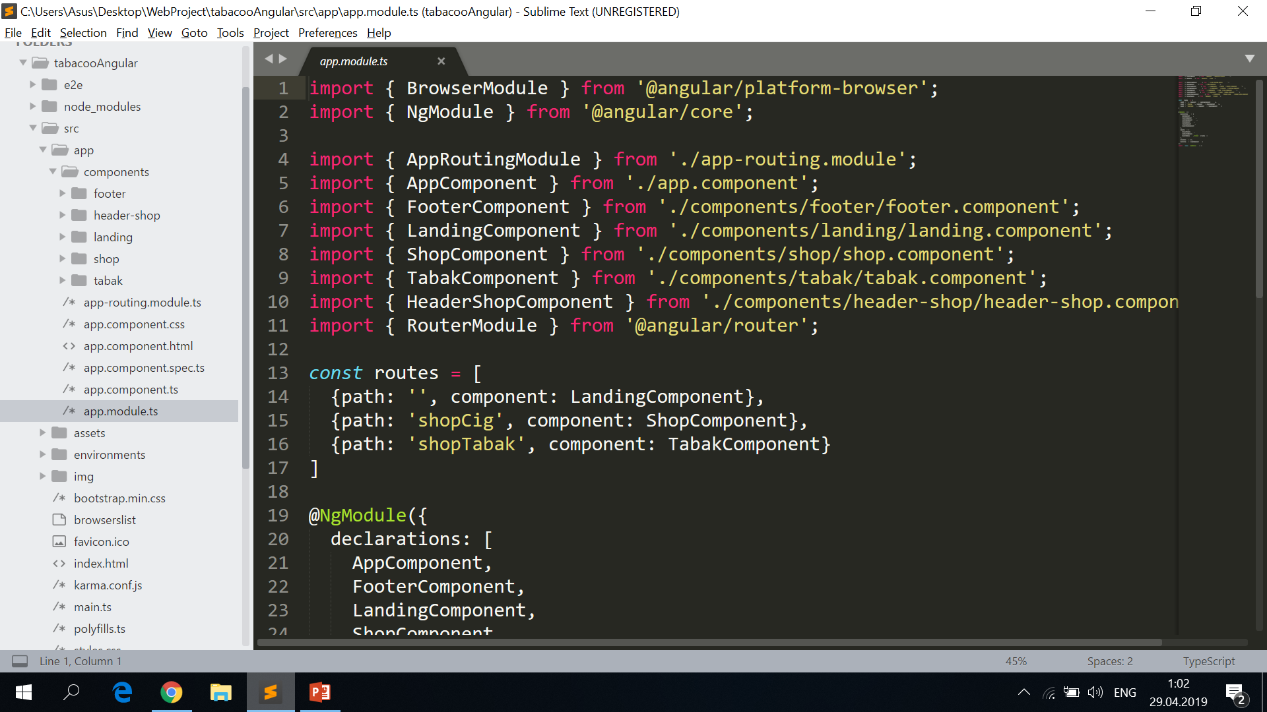

Slide 22
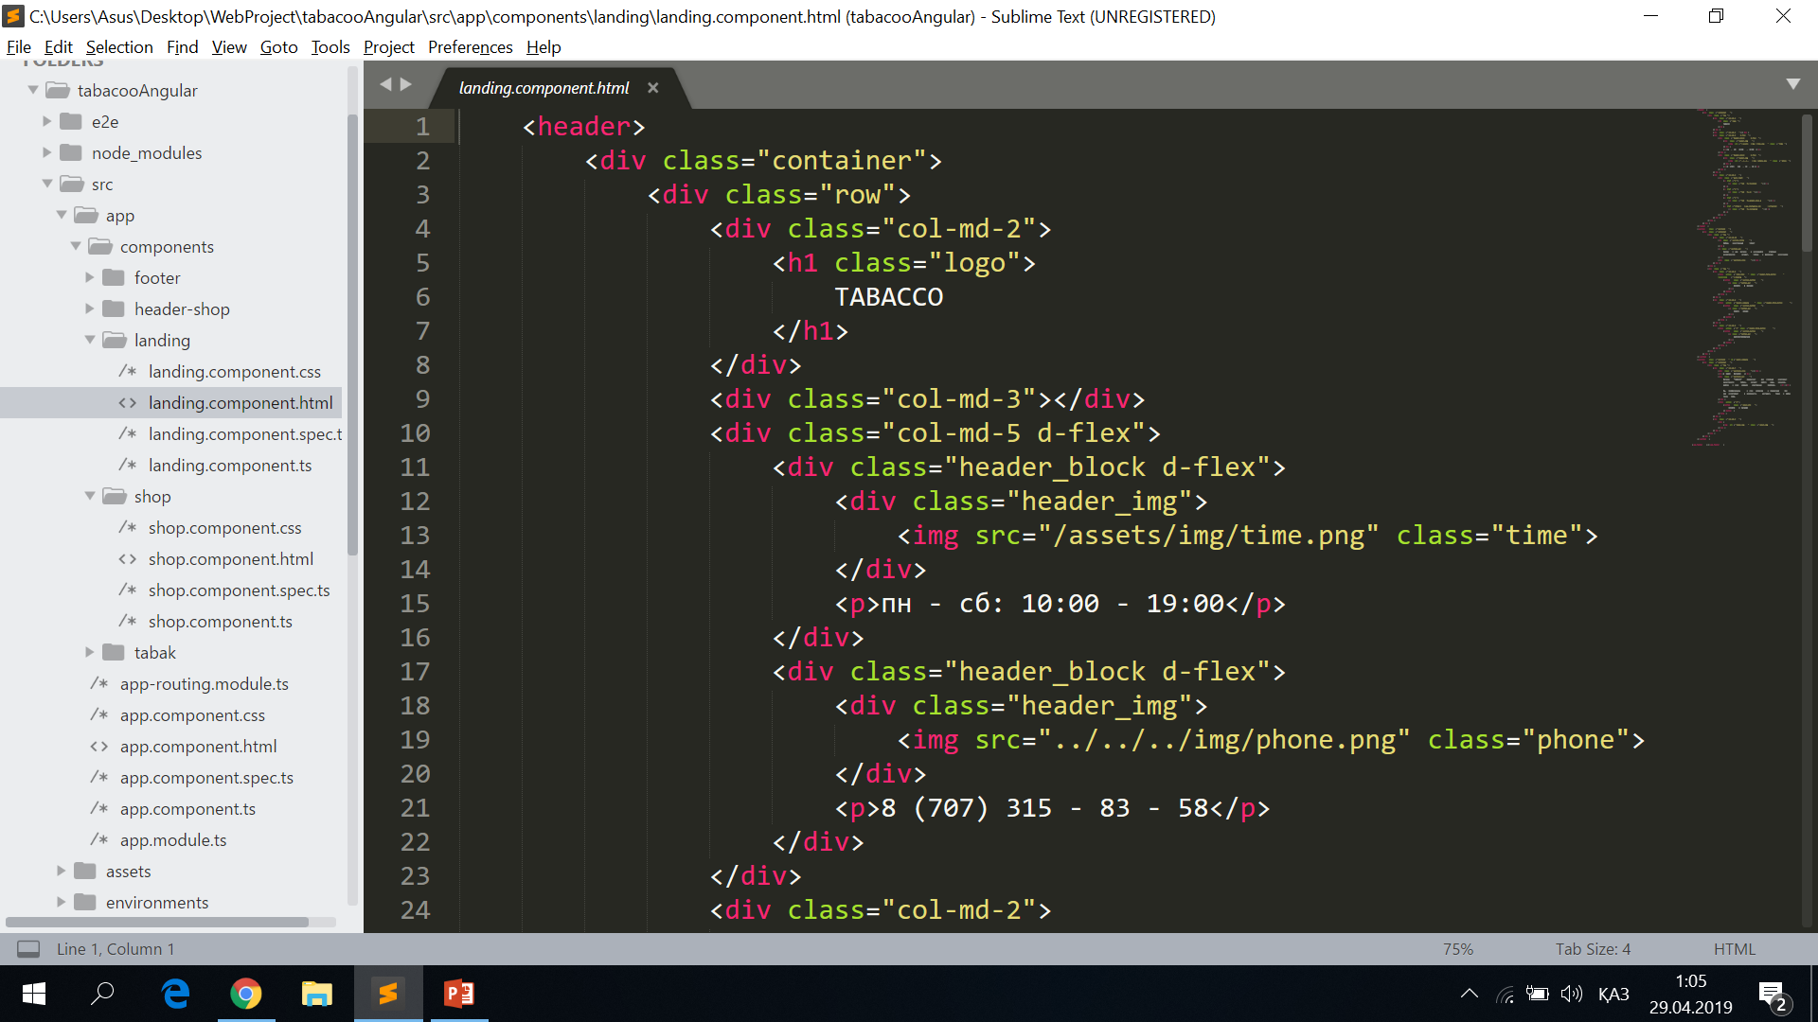

Slide 23
Database structure
ID(PK) | Name | Price | Amount | Category(FK)
1 | Parlament | 460 | 10 | 1
2 | Marlboro | 400 | 20 | 1
3 | Iqos | 30000 | 30 | 2
4 | Alajaama | 850 | 20 | 3
ID(PK) | Category
1 | Cigarettes
2 | Electronic gadgets
3 | Tabacco
ID(PK) | Login | Password
1 | madiyar99 | 12345
2 | rustam25 | 0000

Slide 24
conclusion
Convenient store for buying exclusive tobacco at real prices
Satisfying the tobacco market
Well designed product
Good technology development

Slide 25
Thanks for attention!

